Slide 1

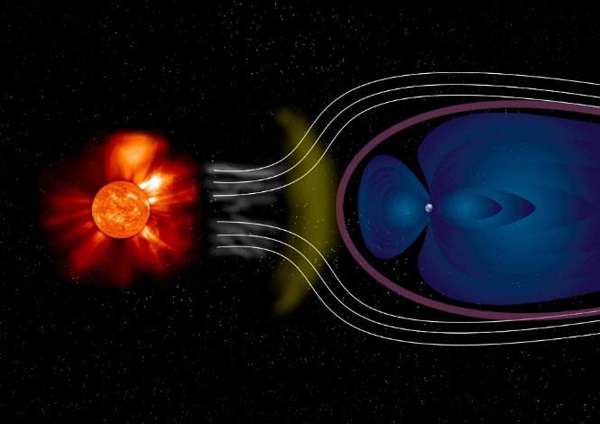
Electromagnetics
# 4
G. M. Parsanasab
References:
[1] David J. Griffiths, Introduction to Electrodynamics-Cambridge University Press (2017).
[2] Cheng, David Keun, Field and wave electromagnetics-Pearson New international ed. (2013_2014).
[3] Purcell E.M., Morin D.J. - Electricity and Magnetism-Cambridge University Press (2013).
[4] Jr. George Brinton Thomas, Christopher Heil, Joel Hass, Przemyslaw Bogacki, Maurice D. Weir, University calculus, early transcendentals (2020).

Slide 2
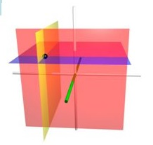
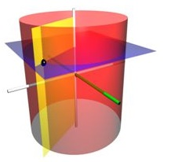
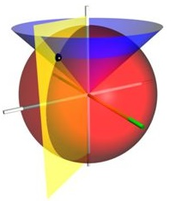
CURVILINEAR COORDINATES

Slide 3
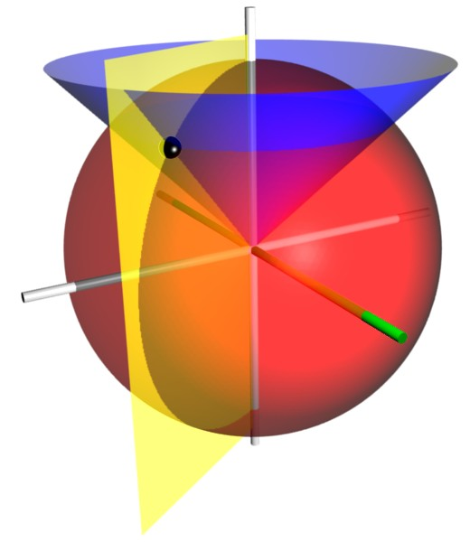
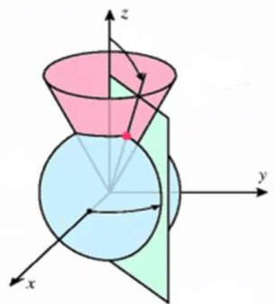
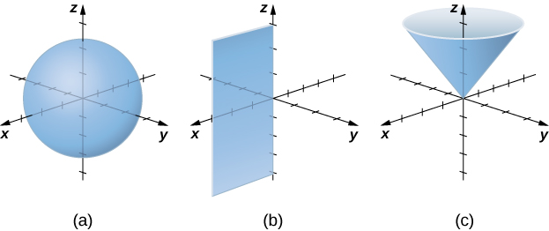

Slide 4
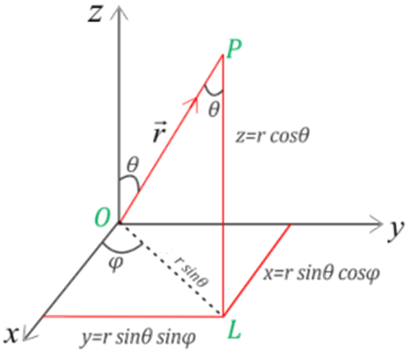
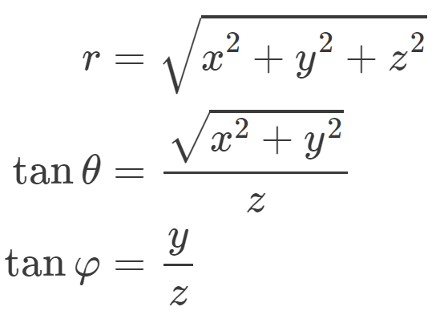
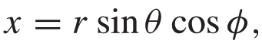
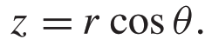
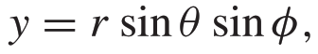
Spherical Coordinates

Slide 5
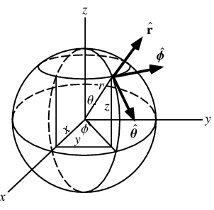
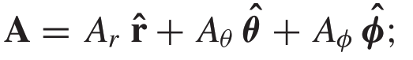
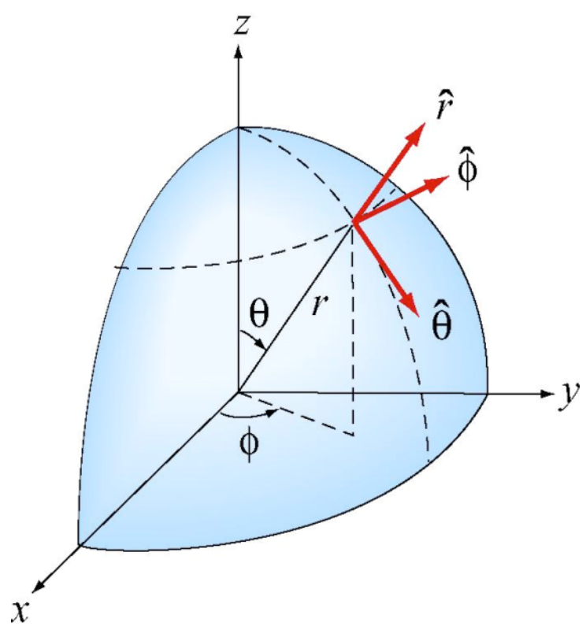
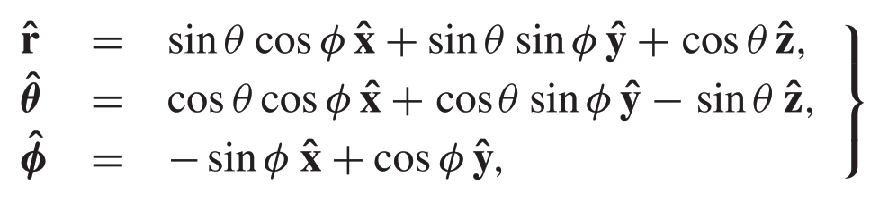
Spherical Coordinates

Slide 6
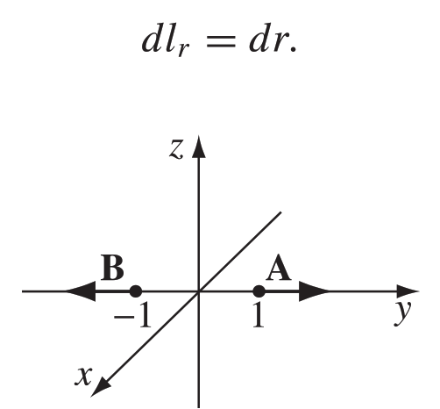

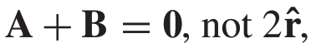
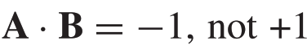
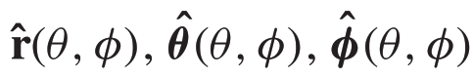
In spherical coordinate:
:are associated with a particular point P,
and they change direction as P moves around.

Slide 7
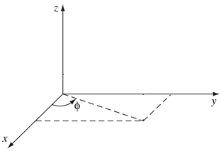
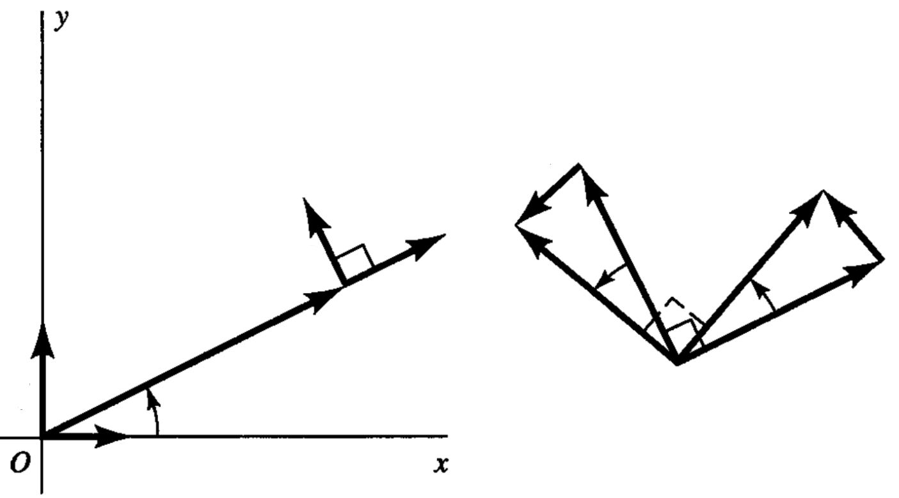
Example
y
x

Slide 8
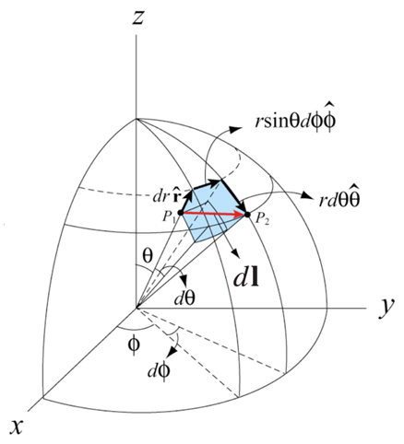
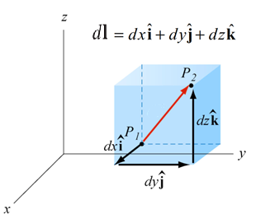
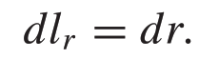
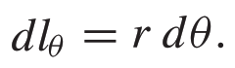
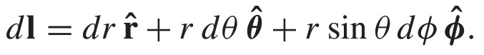
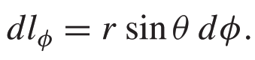

Slide 9
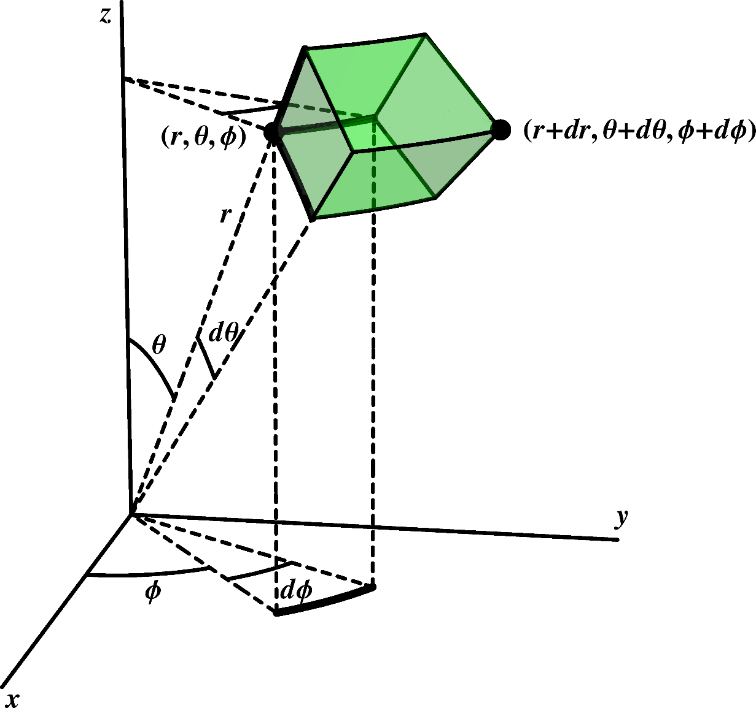


Slide 10

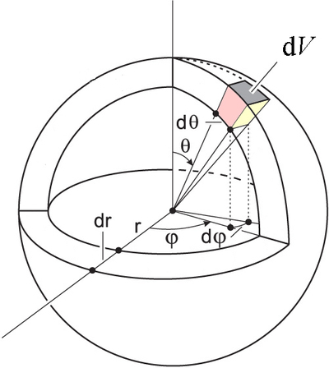

Slide 11
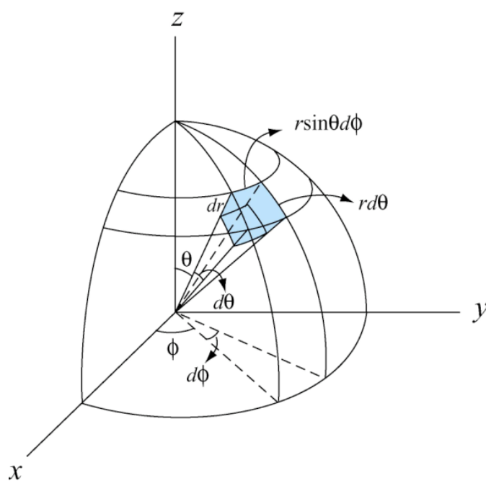
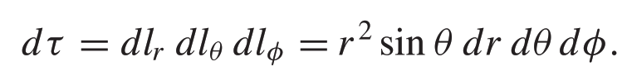
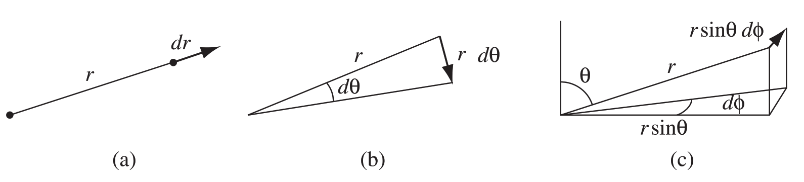

Slide 12
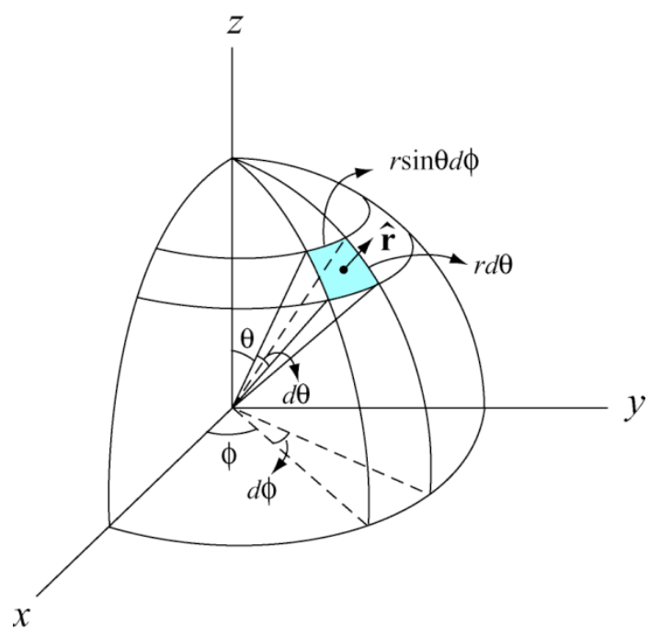
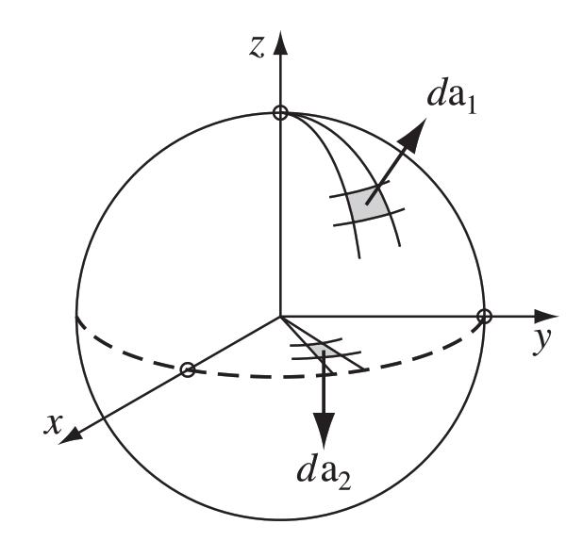
12

Slide 13
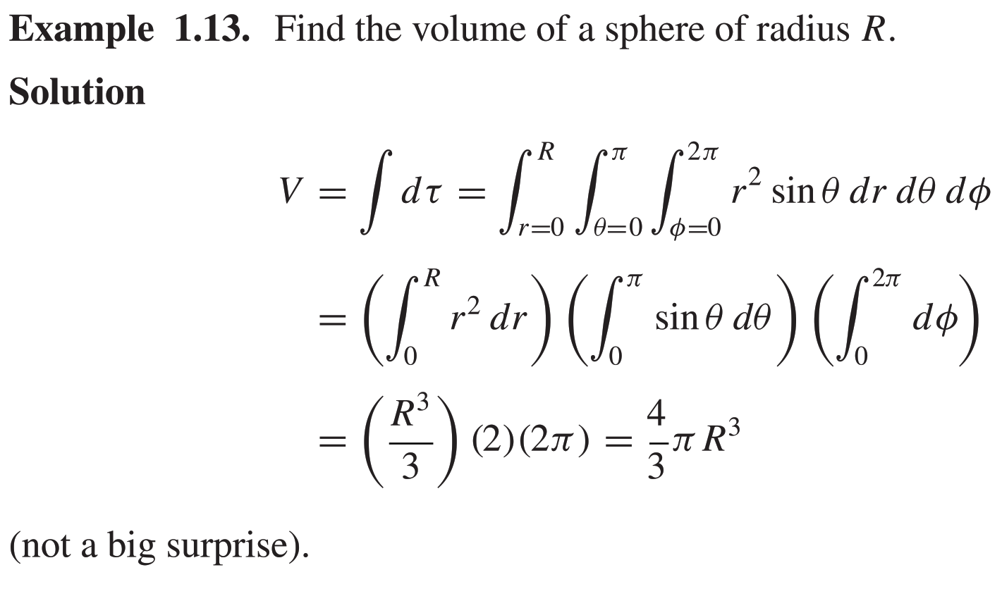

Slide 14
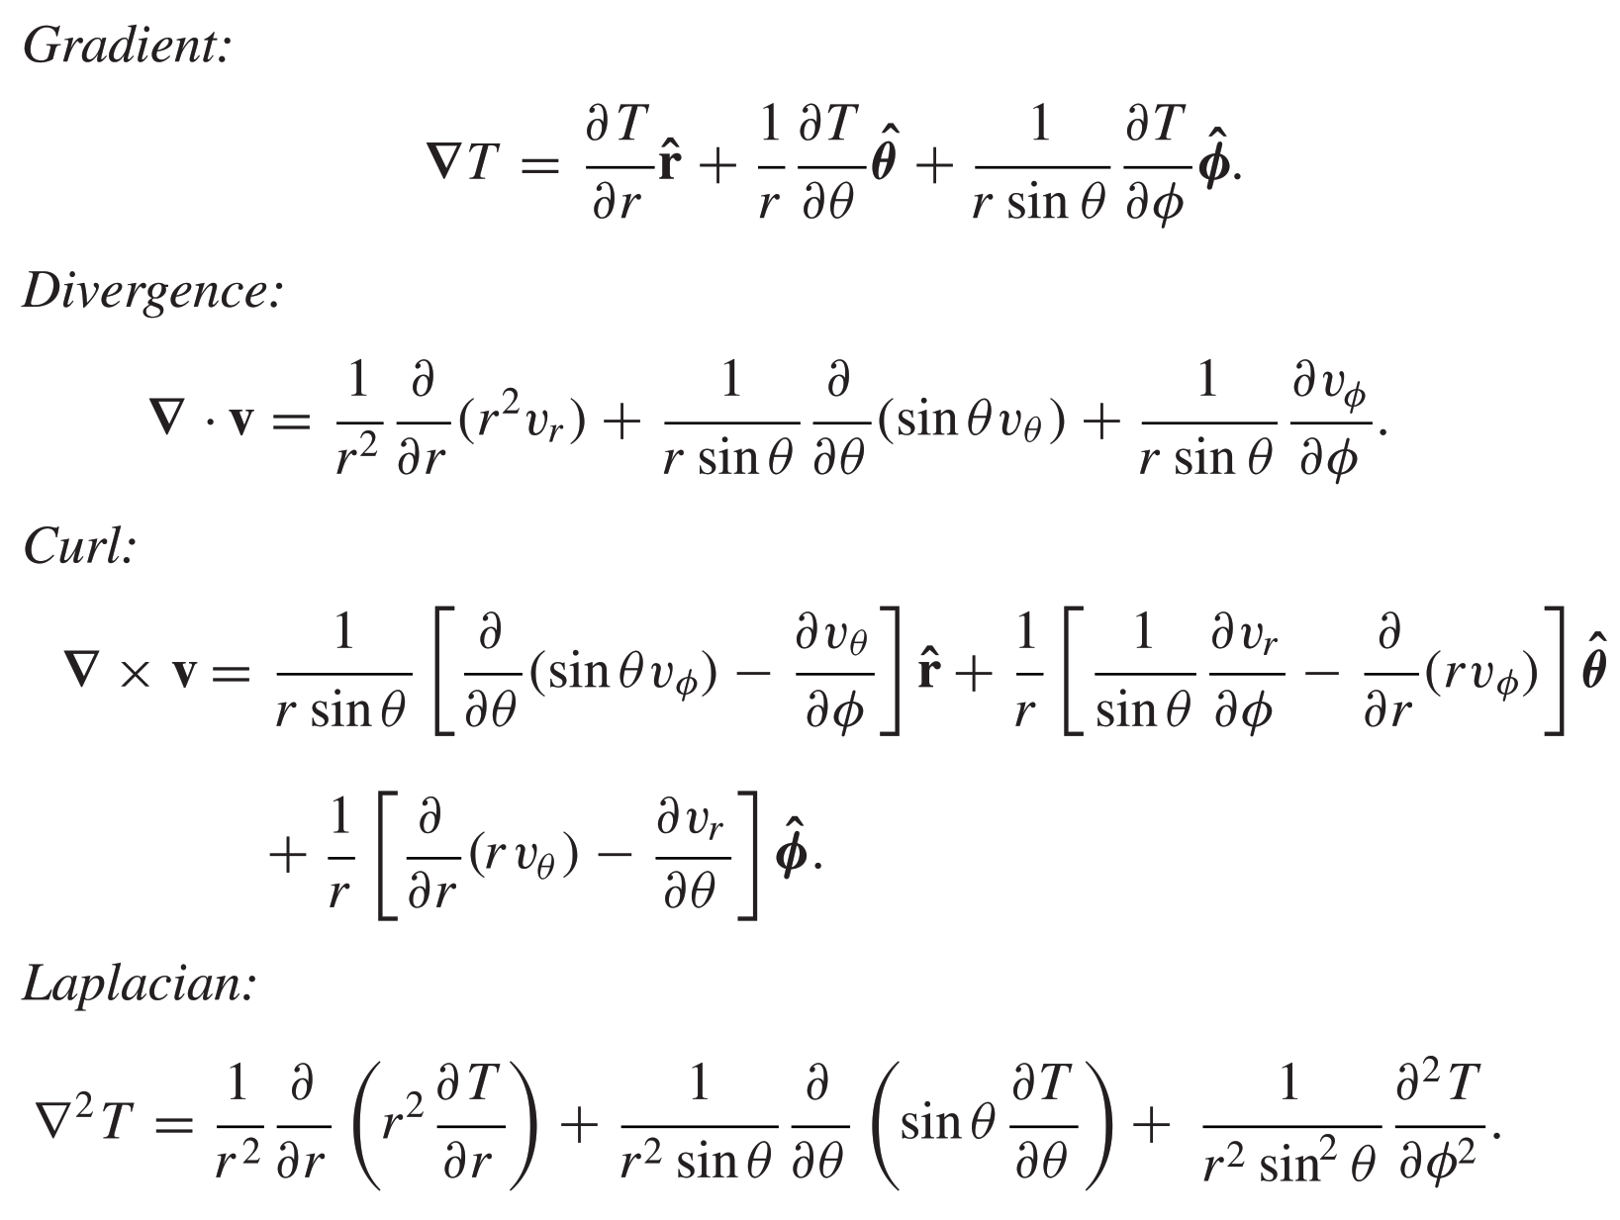

Slide 15
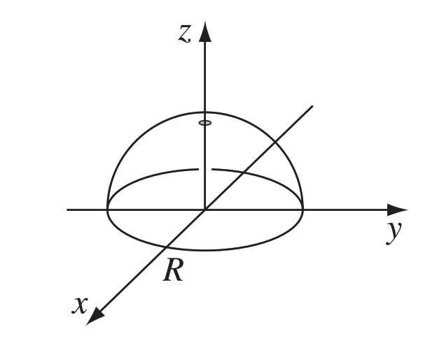
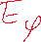
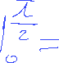
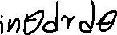
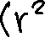
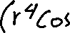
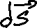
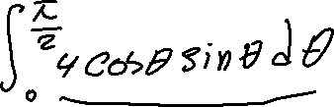

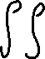
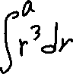
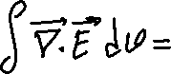
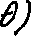
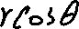









Example
Test the divergence theorem for the function: Take as your volume the hemisphere with a radius of “a” shown in below Fig
a

Slide 16


Slide 17



Cylindrical Coordinates

Slide 18






Slide 19


Slide 20


Example
Consider a vector field given by:
Is v conservative?
Test the curl theorem for the this function.
For s=R:
R

Slide 21





Potentials
If the curl of a vector field (F) vanishes (everywhere), then F can be written as the gradient of a scalar potential(V ):
The potential is not unique—any constant can be added to V with impunity, since this will not affect its gradient.

Slide 22



If the divergence of a vector field (F) vanishes (everywhere), then F can be expressed as the curl of a vector potential(A):
vector field F can be written as the gradient of a scalar plus the curl of a vector

Slide 23













Example
Given a vector function:
a)Determine the constants a, b, and c if F is irrotational.
b) Determine the scalar potential function V whose negative gradient equals F.

Slide 24





















Slide 25






Dirac Delta Function
Does this mean that the divergence theorem is false?
What’s going on here?
The entire contribution must be coming from the point r = 0

Slide 26


Dirac Delta Function δ(x)
“ spike ”
A generalized function, or distribution.

Slide 27

The limit of a sequence of functions:

Slide 28






Slide 29







Slide 30


Slide 31




Slide 32









Slide 33


Slide 34




